Slide 1
HOTEL BOOKING
ANALYSIS

Slide 2
POWER BI

Slide 3
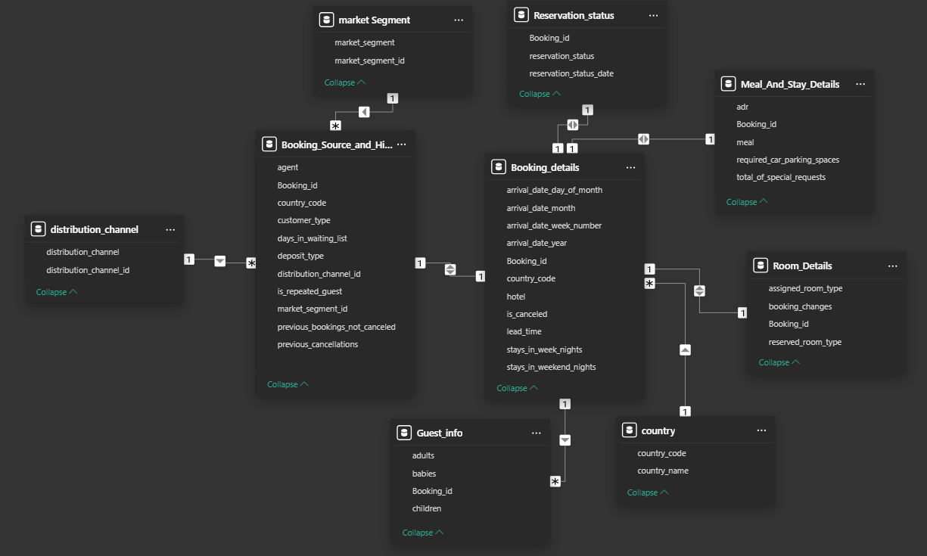
Relationship between tables

Slide 4
Some information before the visualization
Here I have the project and its name is Hotel booking analysis first of all take a data from git hub on hotel booking analysis and then load the data into power bi one by one then after load the data then go to transform the data then I’m entered in the power query editor then do some basic task cleaning , trim and etc. here we can check the null row and some column which is not required to analysis and cleaning the data by power find insight from the data basically I have a already key insight of the data after cleaning the then left the having the option close and apply then click on it after that I’m entered into the visualization part and solve the insight by visualization.

Slide 5
Problem Statement
Analyze booking patterns, guest preferences, and factors influencing cancellations. Use SQL and Excel to identify trends in booking sources and revenue. Develop a Power BI dashboard for tracking booking trends and optimizing hotel operations.

Slide 6
Power bi questions
These are the questions that you will need to answer after doing the required analysis. (Note: You may earn bonus marks by providing additional analysis.)
Visualize booking trends over the years, including the number of bookings, cancellations, and average lead time. Identify seasonality patterns.
Analyze monthly booking patterns to identify peak months and optimize marketing strategies.
Compare stays in weekend nights and weekday nights to determine preferences and variations by hotel type.
Calculate and visualize the booking conversion rate (canceled bookings to total bookings) over time.
Visualize the distribution of adults, children, and babies in bookings. Explore the impact of children and babies on cancellation rates.
Analyze the distribution of Average Daily Rates (ADR) and identify correlations with the number of special requests made by guests.
Visualize the relationship between the number of required car parking spaces and booking types (Resort Hotel vs. City Hotel).
Use Power BI to explore how the total number of special requests made by guests varies by hotel type and customer type (e.g., Transient, Group).
Explore meal plans and their impact on Average Daily Rates (ADR). Analyze meal plan preferences and their association with booking channels.
Analyze how meal plans correlate with stay duration and investigate any differences in stay lengths based on meal plans.
Correlate parking requirements and special requests with different meal plans. Determine if certain meal plans result in more requests or parking needs.
Explore how meal plans are distributed across various booking channels. Analyze if certain channels are associated with specific meal plans.
Visualize booking distribution across different market segments and analyze cancellation rates within each segment.
Compare the effectiveness of booking distribution channels in generating confirmed bookings. Identify the most commonly used channels by guests.
Visualize the percentage of repeated guests for each hotel type (Resort Hotel vs. City Hotel) over time. Explore factors influencing guest retention.
Analyze the impact of a guest's booking history (previous cancellations and non-canceled bookings) on their likelihood of canceling a current booking.
Visualize the distribution of reserved and assigned room types. Analyze whether guests tend to receive the room type they initially reserved.
Investigate the relationship between the number of booking changes made by guests and their likelihood of canceling a booking.
Analyze room type preferences based on customer types (e.g., Transient, Group) and identify any patterns in room type selection.
Analyze whether guests who make multiple bookings tend to consistently request the same room type or if their preferences change over time.
Provide an overview of reservation statuses over time, including the percentage of canceled, checked-out, and no-show bookings.
Analyze trends in reservation status dates, such as the busiest checkout dates or patterns in cancellations by month.
Visualize how reservation statuses vary across different customer types (e.g., Transient, Group) and identify if certain customer types are more likely
to result in cancellations or no-shows.
24. Explore the relationship between reservation statuses and Average Daily Rates (ADR) to determine if there are differences in ADR based on booking outcomes.

Slide 7
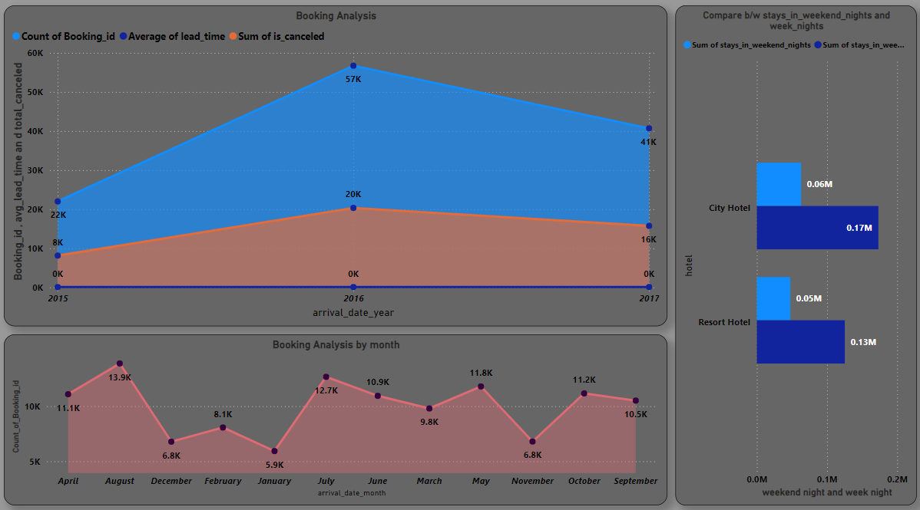

Slide 8
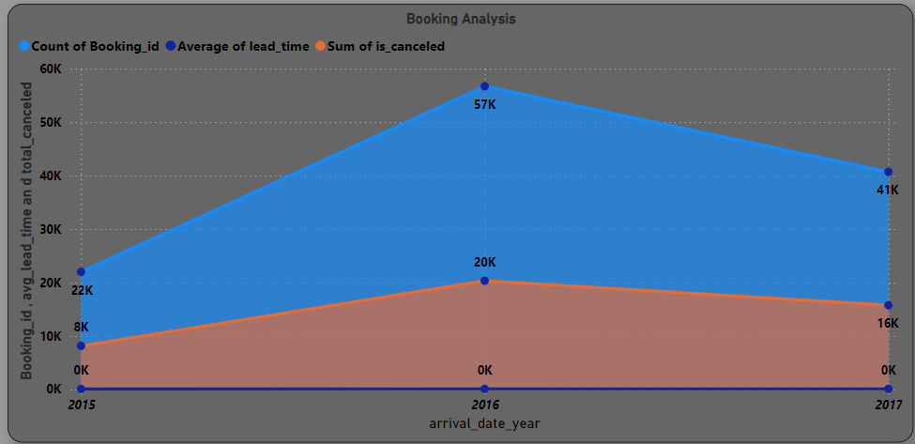
1. Visualize booking trends over the years, including the number of bookings, cancellations, and average lead time. Identify seasonality patterns.
Here I’m the select the line chart and then select the data Booking details tables and then selecting the 4 column from this table. Arrival_date_year , booking_Id ,lead_Time , Is_canceled . Then put the arrival_date_year column put in the x- axis to show year wise data and count of booking_id , average lead_Time and sum of Is_canceled all the column put in the y-axis then do some basic formatting to attractive visualization.

Slide 9
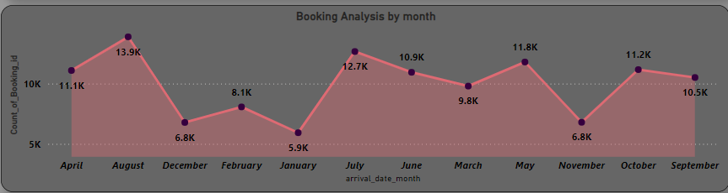
2. Analyze monthly booking patterns to identify peak months and optimize marketing strategies.
Here I’m the select the line chart and then select the data from Booking details tables and then selecting the 2 column from this table. Arrival_date_month , booking_Id . Then put the arrival_date_month column put in the x- axis to show month wise data and count of booking_id then column put in the y-axis then do some basic formatting to attractive visualization. Herre we can see the in month of august are highest count of booking and mostly booking doing the august , July and may .

Slide 10
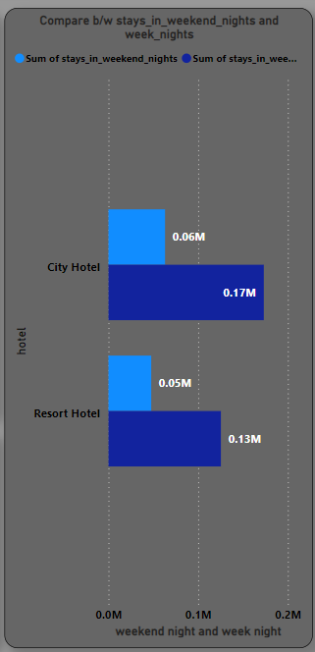
3. Compare stays in weekend nights and weekday nights to determine preferences and variations by hotel type.
Here I’m selecting the bar chart to show the hotel wise sum of weekend night and weekday nights. First of selecting the data from booking details and then selecting the column hotel, stays in weekend nights and stays in weekday nights. After that hotel column put in the y –axis and stays in weekends nights and weekday nights put in the x – axis and sum of both column then doing some formatting like font , color etc to show attractive visualization and we can see that clearly city having the highest stay in weekday nights and weekend night both are high than resort hotel.

Slide 11
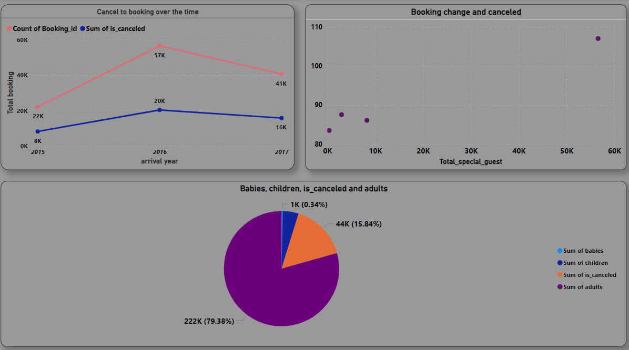

Slide 12
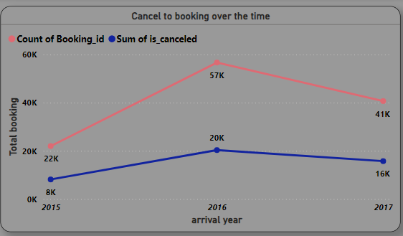
4. Calculate and visualize the booking conversion rate (canceled bookings to total bookings) over time.
Here I’m the select the line chart and then select the data Booking details tables and then selecting the 4 column from this table. Arrival date year , booking Id and Is canceled Then put the arrival date year column put in the x- axis to show year wise data and count of booking id and sum of Is canceled the column put in the y-axis then do some basic formatting like font ,color etc to attractive visualization. Here we can see that clearly in 2016 booking on the peak and is canceled also shows the peak in 2016.

Slide 13
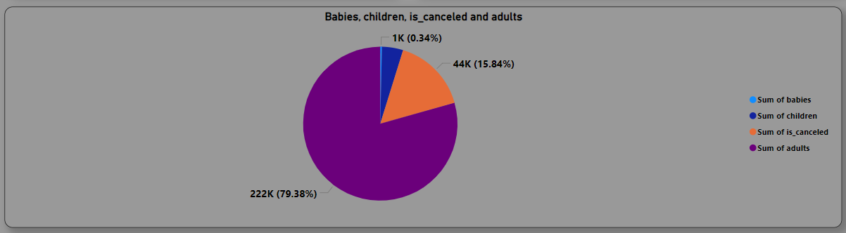
5. Visualize the distribution of adults, children, and babies in bookings. Explore the impact of children and babies on cancellation rates.
Here I’m selecting the pie chart Then selecting the data from two different table (booing details and guest info) . Selecting the column from the table babies, children , adults from guest info table and is canceled from booking details after selecting the column put in the value then its automatic summarize the column and give the sum of all column is canceled, adults, children , babies then doing the basic formatting like font ,color etc for better attractive visualization and we can see that clearly its show the percentage and value of data .

Slide 14
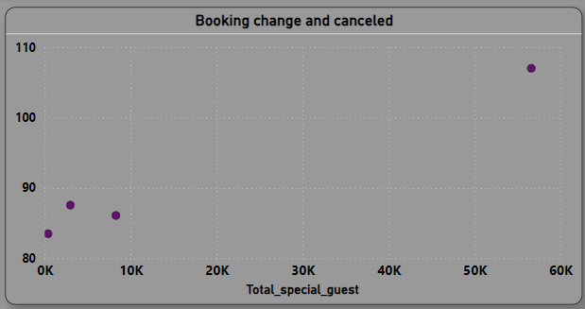
5. Analyze the distribution of Average Daily Rates (ADR) and identify correlations with the number of special requests made by guests.
Here I’m selecting the scatter chart and then selecting the data from booking source and history and meals and stays details tables and then selecting the column from table ADR and total of special request from meals and stays details . Customer type column from booking source and history table and then adr column put in the y-axis and total of special requests put in x-axis and customer type column put in the value after that doing some basic formatting like font ,color etc for better and attractive visualization and we can see that is show the relation between data.

Slide 15
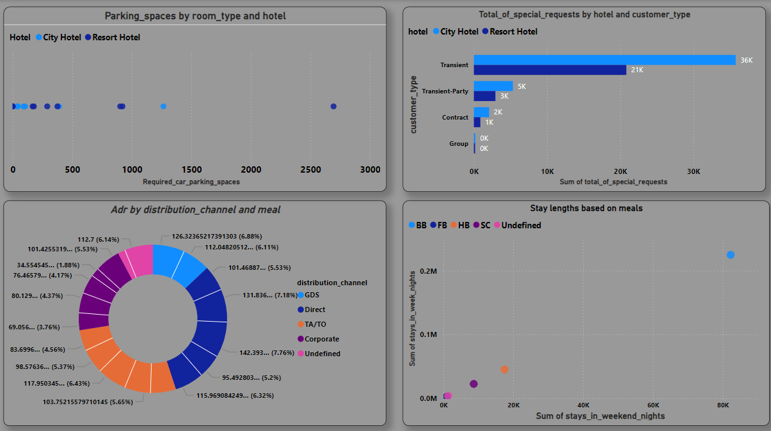

Slide 16
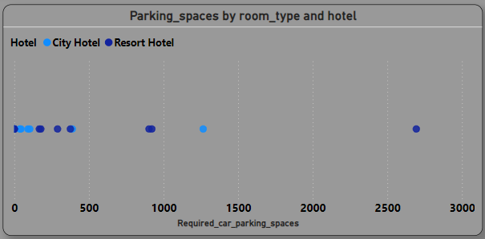
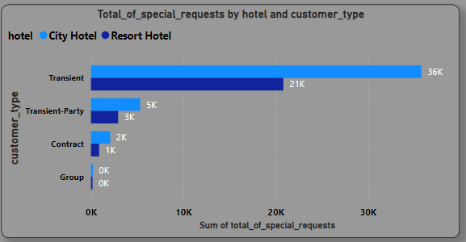
7. Visualize the relationship between the number of required car parking spaces and booking types (Resort Hotel vs. City Hotel).
Here I’m selecting scatter chart and selecting the data then selecting the table and then selecting the column booking details , meals and stays details and room details tables then selecting the column hotel from booking details put in the legend and reserved room type from room details put in the value and required car parking spaces from meal and stays details table put in the x-axis and its gives the summarization of that column then its gives the sum of required car parking space in doing some basic formatting like font , color etc to better and attractive visualization we can see that hotel wise car parking space and room in the scattar chart.
8. Use Power BI to explore how the total number of special requests made by guests varies by hotel type and customer type (e.g., Transient, Group).
Here I’m selecting the bar chart to show the hotel wise sum of special requests and customer type . First of selecting the data from booking details and then selecting the column hotel,. After that hotel column put in the legend and customer type column from booking source and history put in the x –axis and total of special request from mela and stays details then put in the x- axis and its gives a sum of total of special guests then doing some formatting like font , color etc to show attractive visualization and we can see that clearly hotel and customer type wise show data and having the highest total of special guest in transient customer type.

Slide 17
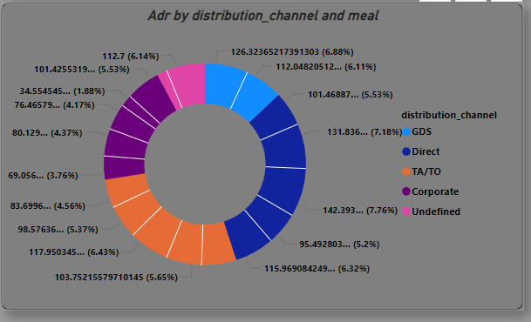
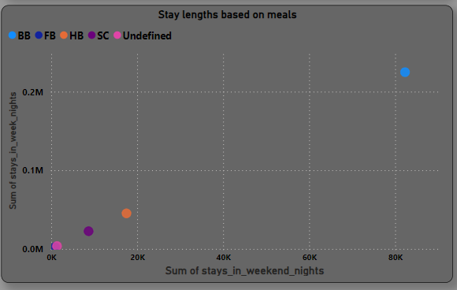
9. Explore meal plans and their impact on Average Daily Rates (ADR). Analyze meal plan preferences and their association with booking channels.
Here I’m selecting the donut chart Then selecting the data from two different table (distribution channel and meal and stays details ) . Selecting the column from the table distribution channel from distribution channel table and selecting the column ADR and meals from meal and stays details after selecting the column meals put in the details and ADR column put in the values its automatic summarize the column and give the average of ADR according which one I’m selecting then doing the basic formatting like font ,color etc for better attractive visualization and we can see that clearly its show the percentage and value of data .
10.Analyze how meal plans correlate with stay duration and investigate any differences in stay lengths based on meal plans.
Here I’m selecting scatter chart and selecting the data then selecting the table and then selecting the column booking details , meals and stays details tables then selecting the column stay in weekday nights and weekend night from booking details and meal from meal and stays details put in the legend and stays in weekend nights column put in the x-axis then summarize give the sum of stays in weekend nights and stays in week nights put in the y –axis gives the sum of week night column after that doing some basic formatting like font , color etc to better and attractive visualization we can see meals by stays length.

Slide 18
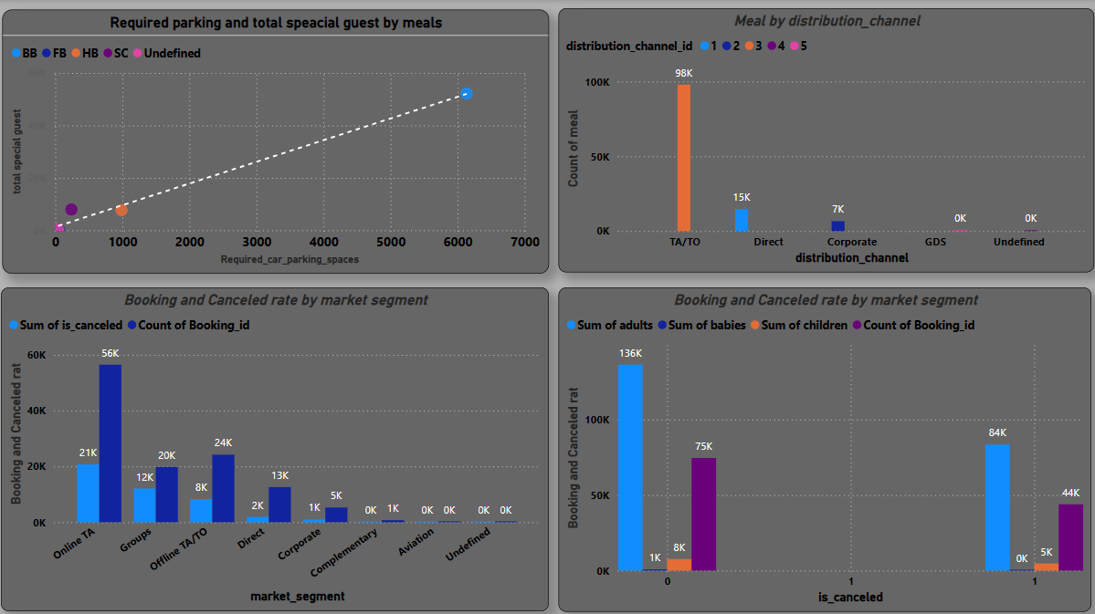

Slide 19
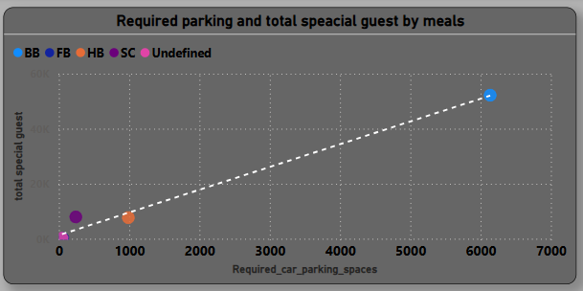
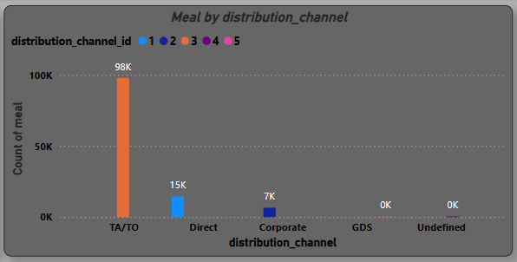
11. Correlate parking requirements and special requests with different meal plans. Determine if certain meal plans result in more requests or parking needs.
Here I’m selecting scatter chart and selecting the data then selecting the table and then meals and stays details tables then selecting the column Required car parking space ,total special guest and meal and meal column put in the legend and required parking space column put in the x- axis and summarize it sum of required parking space and total special guest column put in the y –axis then summarize it and gives a sum of total special guest and do some basic formatting to attractive visualization and its show by relationship between total special guest and required parking space.
12.Explore how meal plans are distributed across various booking channels. Analyze if certain channels are associated with specific meal plans.
Here I’m selecting the Column chart . First of selecting the data from meal and stays details and then selecting the column meal. After that meal column put in the y –axis and gives a count of meals and distribution channel column from distribution column and put in the x –axis and distribution channel id from distribution channel table then put in the legend and then doing some formatting like font , color etc to show attractive visualization and we can see that clearly meal by distribution channel and highest distribution channel is TA/TO.

Slide 20
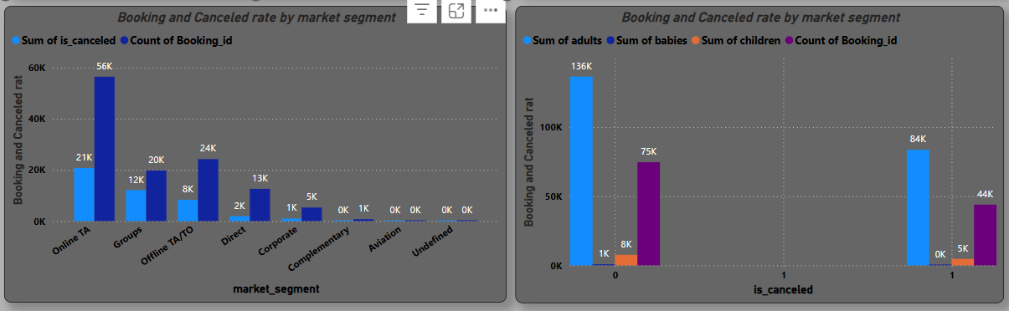
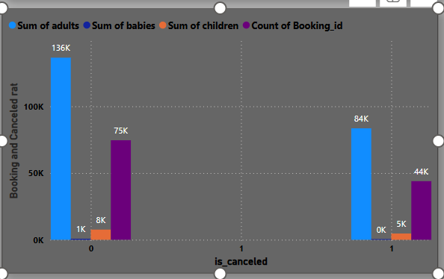
13. Visualize booking distribution across different market segments and analyze cancellation rates within each segment.
14. Compare the effectiveness of booking distribution channels in generating confirmed bookings. Identify the most commonly used channels by guests.
Here I’m selecting the Column chart . First of selecting the data from market segment and then selecting the column market segment. After that market segment column put in the x –axis and is canceled and booking id From booking details put in the x –axis then booking id count of bookings and sum of is canceled then doing some formatting like font , color etc to show attractive visualization and we can see that clearly cancellation rate and booking by each market market segment top 1 is online TA.
Here I’m selecting the Column chart . First of selecting the data from booking details and guest info table. Then selecting the column is cancel from booking details and all column from guest column like adult ,babies , children and booking id put in the y –axis and give the sum of adult ,babies , children and count of booking id. And is canceled column put in the x-axis then do some basic formatting to attractive visualization and we can see clearly is canceled by when not cancel booking and cancel booking.

Slide 21
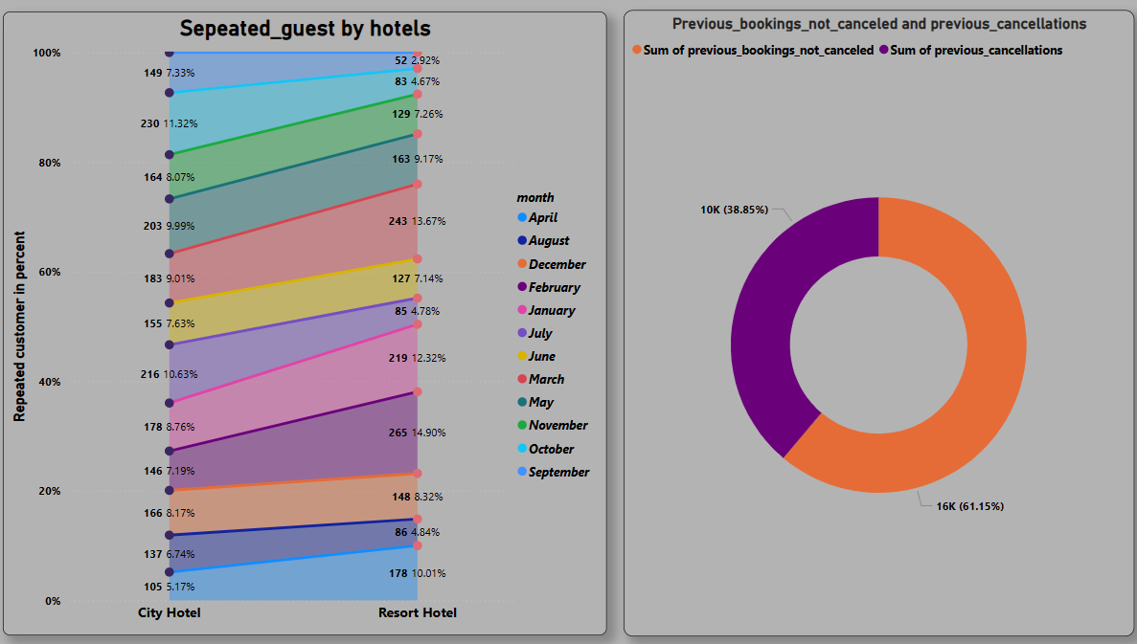

Slide 22
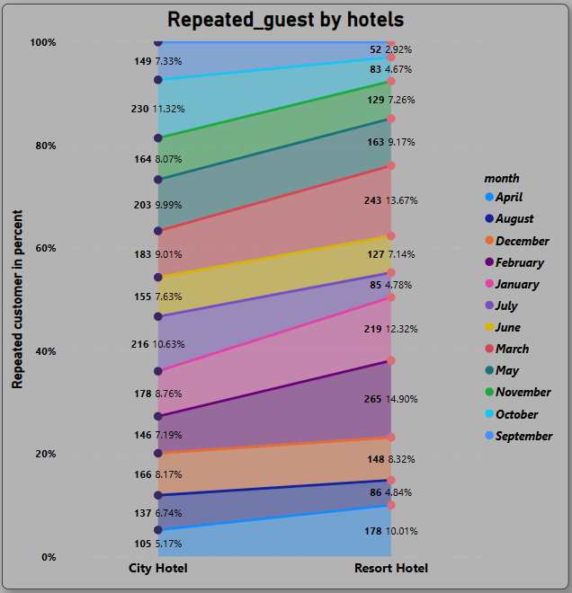
15.Visualize the percentage of repeated guests for each hotel type (Resort Hotel vs. City Hotel) over time. Explore factors influencing guest retention.
Here we are select the 100% stack area chart
Then selecting the Booking details and booking source and history table then selecting the column arrival date month and hotel from booking details table and is repeated guest from booking source and history table and is repeated column put in the y –axis then summarize then gives the sum of repeated guest and arrival date month put in the legend and hotel column put in the x- axis then doing the some basic formatting like font , color etc to attractive visualization. We can see that clearly month wise repeated guest by hotel.

Slide 23
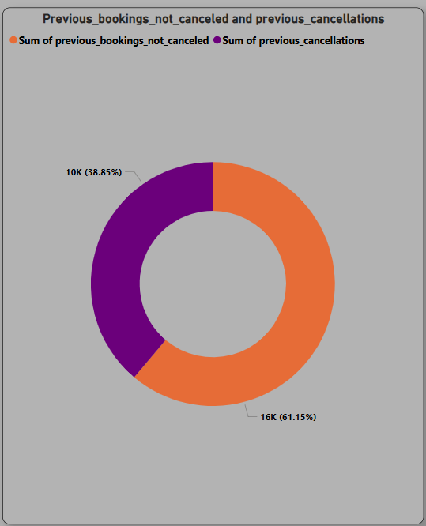
16.Analyze the impact of a guest's booking history (previous cancellations and non-canceled bookings) on their likelihood of canceling a current booking.
Here I’m selecting the donut chart Then selecting the data from two different table (booing source and history) . Selecting the column Previous booking not canceled and previous cancellation from the booing source and history table and put in the value then its automatic summarize the column and give the sum of both column then doing the basic formatting like font ,color etc for better attractive visualization and we can see that clearly its show the percentage and value of data .

Slide 24
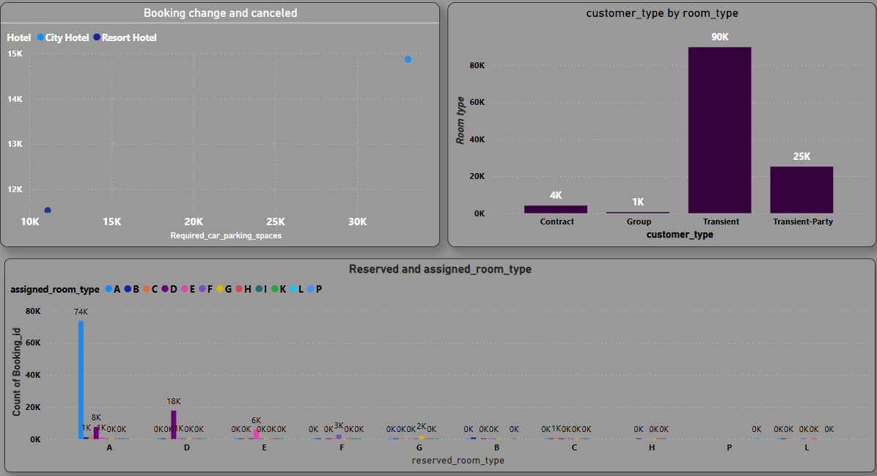

Slide 25
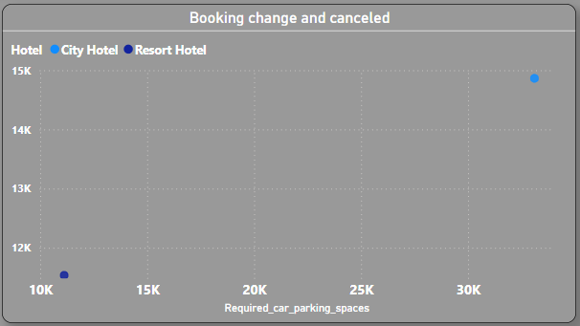
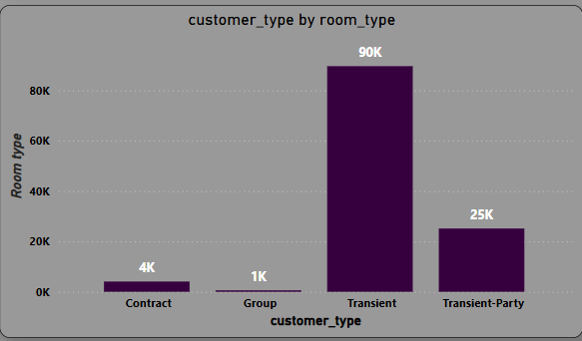
17. Investigate the relationship between the number of booking changes made by guests and their likelihood of canceling a booking.
17. Analyze room type preferences based on customer types (e.g., Transient, Group) and identify any patterns in room type selection.
Here I’m selecting scatter chart and selecting the data then selecting the table and then selecting the column From booking details and room details tables then selecting the column hotel from booking details put in the legend and booking changes from room details put in the y-axis and is canceled column select from booking details and put in the x-axis and its gives the summarization of that column then its gives the sum of is canceled then doing some basic formatting like font , color etc to better and attractive visualization we can see that hotel wise booking changes and cancellation in the scattar chart.
Here I’m selecting the Column chart . First of selecting the data from booking source and history and room details then selecting the column customer type and assigned room type. After that customer type column put in the x –axis and assigned room type column put ion the y-axis and its summarize it and gives the count of assigned room type then doing some basic formatting like font ,color etc to show attractive visualization. We can say that clearly here transient customer is highest.

Slide 26
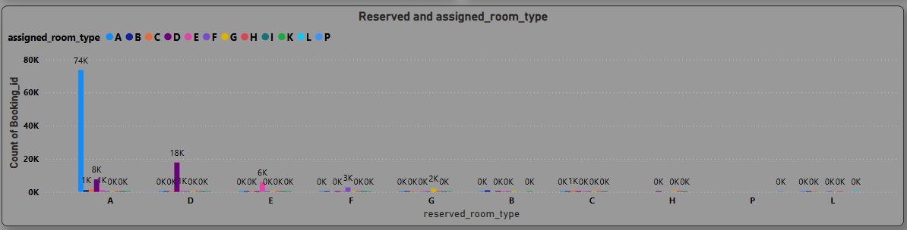
19. Visualize the distribution of reserved and assigned room types. Analyze whether guests tend to receive the room type they initially reserved.
Here I’m selecting the Column chart . First of selecting the data from rooms details table Then selecting the column assigned room type , booking id and reversed room type and then booking id column put in the y –axis and give the count of booking id. And reversed room type column put in the x-axis and assigned room type column put in column legend then do some basic formatting to attractive visualization and we can see clearly room type(A) is highest .

Slide 27
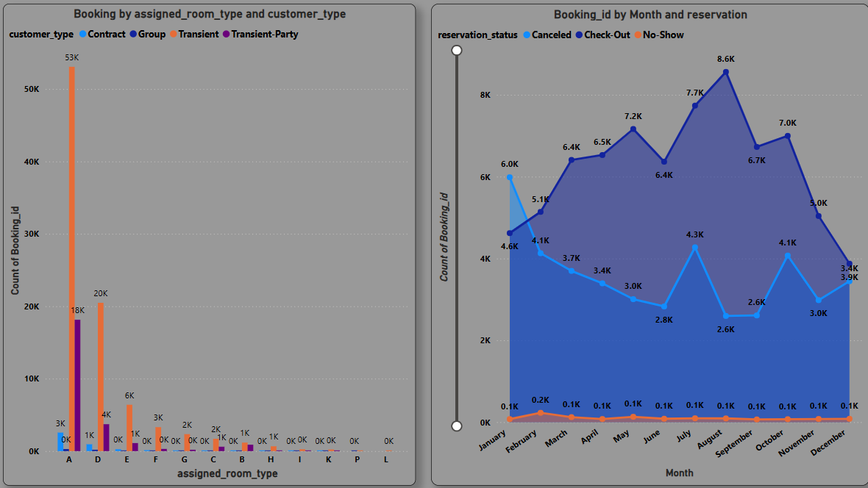

Slide 28
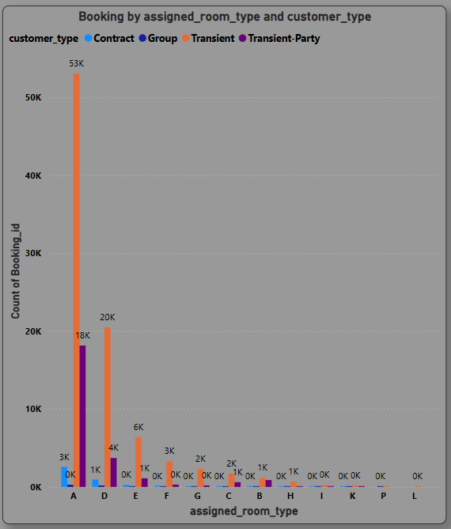
20. Analyze room type preferences based on customer types (e.g., Transient, Group) and identify any patterns in room type selection.
Here I’m selecting the column chart then selecting the table (room details and booking source and details) from the data then selecting the column assigned room type from room details then put in the x- axis and customer type and booking id from booking source and details. Then customer type column put in the legend and booking id column put in the y –axis then its summarize then its gives count of booking id then doing some basic formatting like font, color etc for attractive visualization. We can see clearly room type(A) is highest one for customer type.

Slide 29
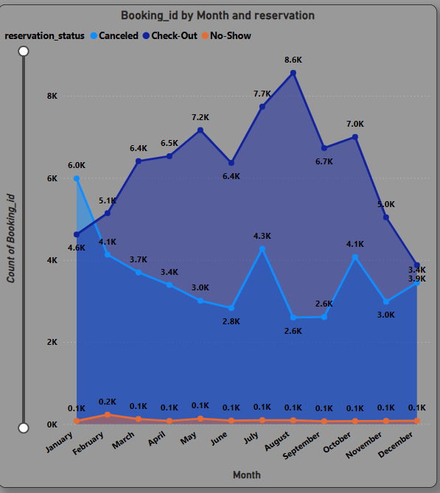
21. Provide an overview of reservation statuses over time, including the percentage of canceled, checked-out, and no-show bookings.
Here I’m selecting the area chart then selecting the table (reservation status then selecting the columns and reservation status column put in the legend and
Reservation status date column put in the x- axis then its create hierarchy then change its to show month wise data and booking id column put in the y –axis then its summarize it and gives the count of booking then doing some basic formatting to attractive visualization like font, color etc and we can see that clearly reservation status (canceled , check- out , no – show )I its show month wise data .

Slide 30
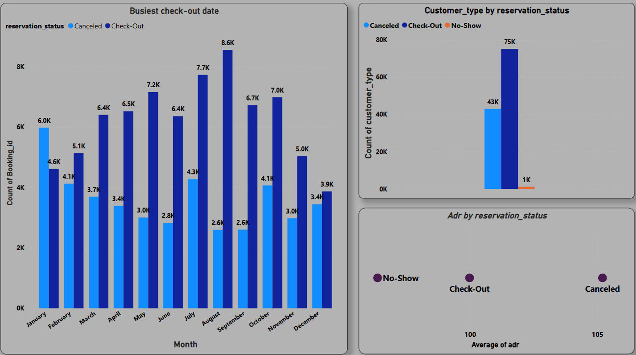

Slide 31
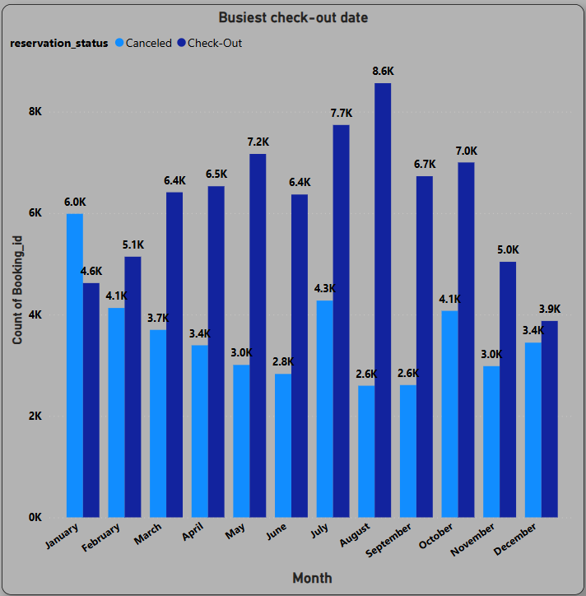
22. Analyze trends in reservation status dates, such as the busiest checkout dates or patterns in cancellations by month.
Here I’m selecting the Column chart . First of selecting the data from booking details and reservation status and then selecting the column reservation status from reservation status table then reservation status column put in the legend and reservation status date column put in the x –axis then status date column create a hierarchy then change it as month and booking id From reservation status table and then put in the y –axis then its summarize it and gives count of bookings then doing some formatting like font , color etc to show attractive visualization and we can see that clearly month wise reservation status .

Slide 32
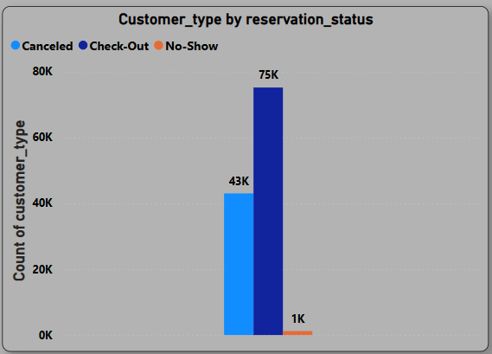
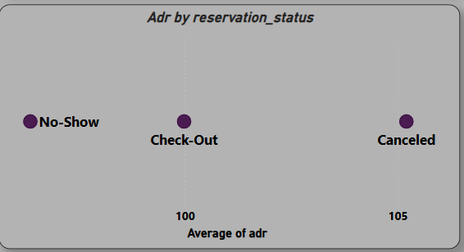
23. Visualize how reservation statuses vary across different customer types (e.g., Transient, Group) and identify if certain customer types are more likely to result in cancellations or no shows.
Here I’m selecting the column chart then selecting the table( reservation status and booking source and history) then selecting the column customer type and reservation status then customer type column put in the y - axis then its summarize it and gives count of customer type and reservation status column put in the legend then doing some basic formatting to attractive visualization. And we can see that clearly check- out is highest one
24. Explore the relationship between reservation statuses and Average Daily Rates (ADR) to determine if there are differences in ADR based on booking outcomes.
Here I’m selecting the scatter chart then selecting the reservation status table and meal and stays details then selecting the column Adr put in the x –axis then its summarize then its gives average Adr and reservation status put in the value then doing some basic formatting for attractive visualization. And we can see that clearly reservation status wise average Adr.

Slide 33
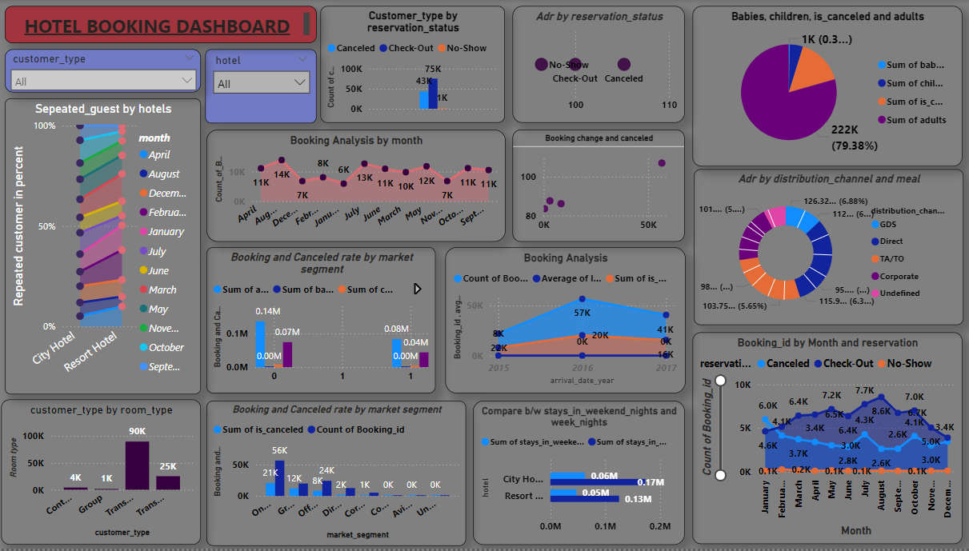

Slide 34
EDA Question

Slide 35
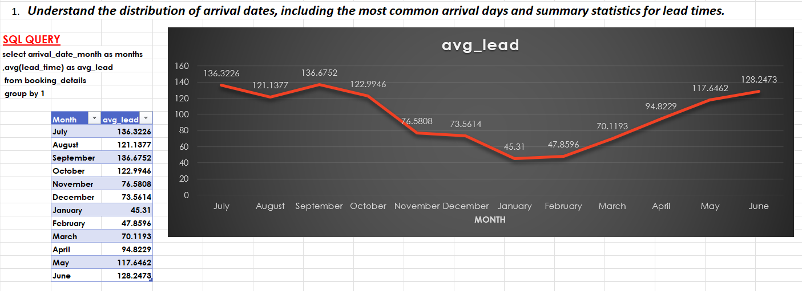
First I’m load the data in the SQL workbench to handle the data and use accordingly which type of the data required . Then write a code on SQL workbench selecting the column arrivals date month and average lead time from booking details then group by arrival date month then run the code and copy the code and data then put in the excel then select the data convert into table and change font size and bold then insert the line chart. Its automatically detect the data according the data month wise average lead time according the months and then selecting the data value and change the color of line is red. We can see that clearly highest lead time in July.

Slide 36
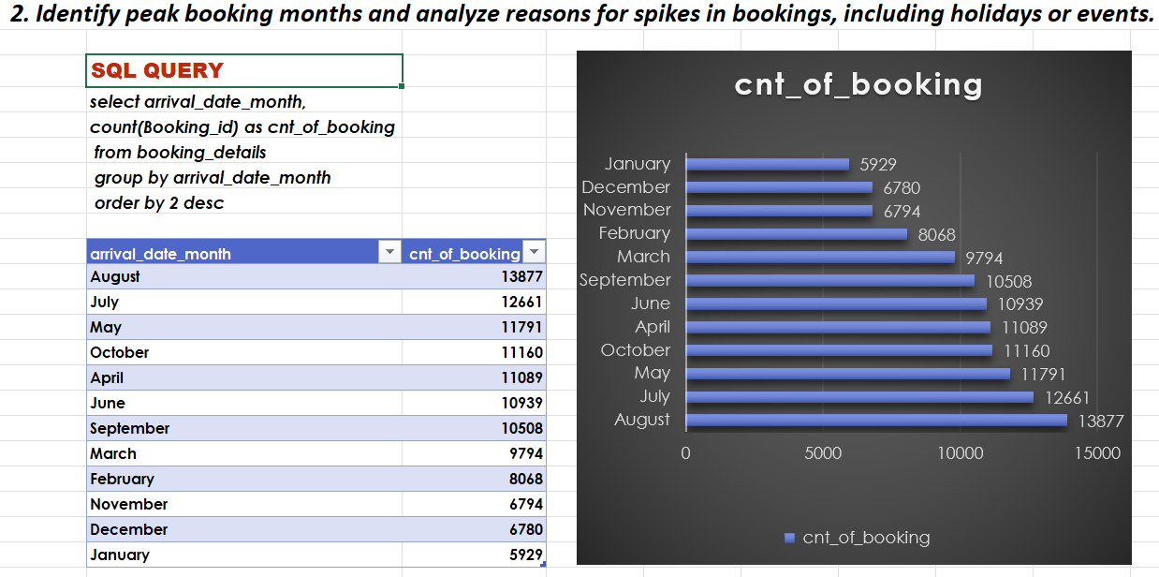
First I’m load the data in the SQL workbench to handle the data and use accordingly which type of the data required . Then write a code on SQL workbench selecting the column arrivals date month and count of booking id from booking details then group by arrival date month and order by count of booking id then run the code and copy the code and data then put in the excel then select the data convert into table and change font size and bold then insert the bar chart. Its automatically detect the data according the data month wise count of booking id according the months and then selecting the data value and change the color of color of column is blue. We can see that clearly highest in august booking .

Slide 37
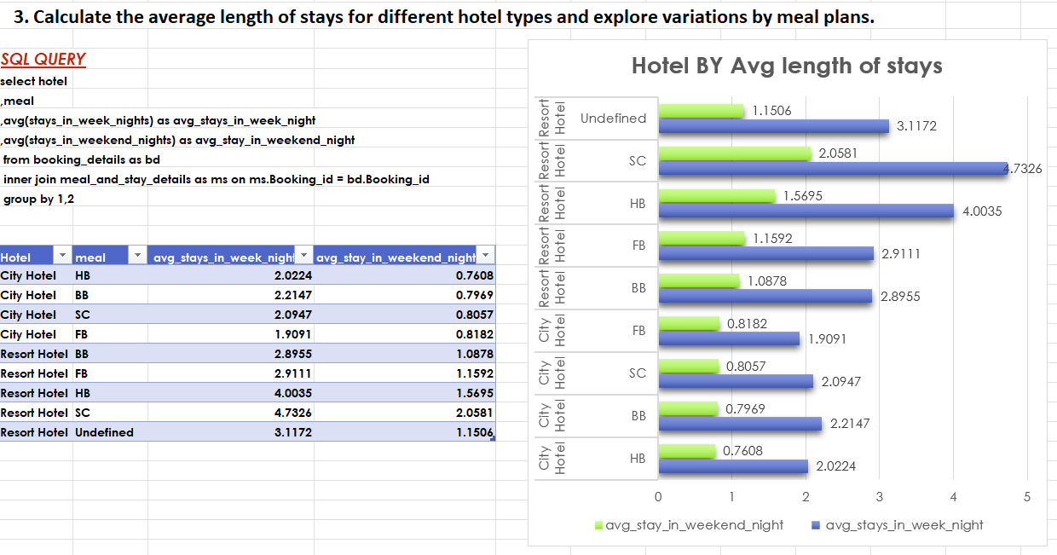
First I’m load the data in the SQL workbench to handle the data and use accordingly which type of the data required . Then write a code on SQL workbench selecting the column hotel ,Meals ,average of stay in week night and average stays in weekend nights from booking details and join the other one table meals and stays details by inner join then group by hotel and melas wise then run the code and copy the code and data then put in the excel then select the data convert into table and change font size and bold then insert the bar chart. Its automatically detect the data according the data hotel and melas wise average stays in week nights and stays in weekend night according the hotel and then selecting the data value and change the color of color of column is blue. We can see that clearly highest in SC meal from resort hotels.

Slide 38
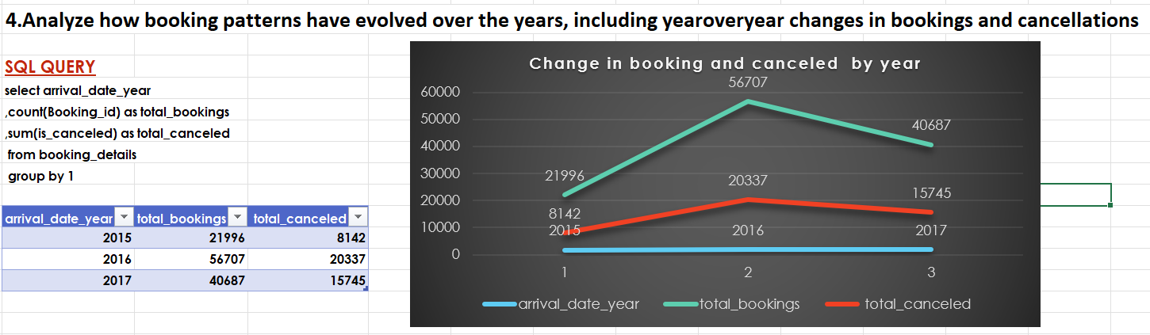
First I’m load the data in the SQL workbench to handle the data and use accordingly which type of the data required . Then write a code on SQL workbench selecting the column arrivals date year and count of booking id as total booking and sum of is canceled as total canceled from booking details then group by arrival date year then run the code and copy the code and data then put in the excel then select the data convert into table and change font size and bold then insert the line chart. Its automatically detect the data according the data year wise total booking and total canceled according the year and then selecting the data value and change the color of line is red. We can see that clearly blue line show year and red line shows total canceled and greenish line shows the total booking and highest one 2016 cancellation rate and total booking.

Slide 39
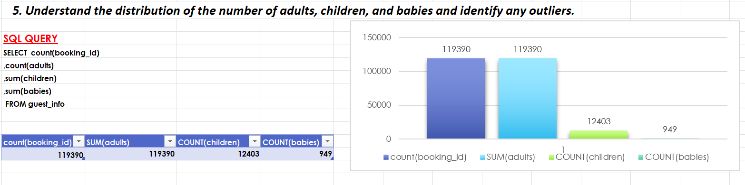
First I’m load the data in the SQL workbench to handle the data and use accordingly which type of the data required . Then write a code on SQL workbench selecting the column count of booking id , , count of adult and sum of children and sum of babies from guest info table . then run the code and copy the code and data then put in the excel then select the data convert into table and change font size and bold then insert the column chart. Its automatically detect the data and then selecting the data value and change the color of color of column is blue. We can see that clearly blue color shows the count of booking Id and lite blue column show the sum of adult and green color show the count of children other one shows count of babies .

Slide 40
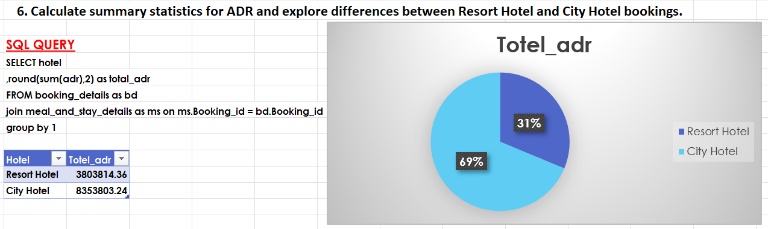
First I’m load the data in the SQL workbench to handle the data and use accordingly which type of the data required . Then write a code on SQL workbench selecting the column hotel and sum of adr column and I’m using the round formula and from booking details and join the meal and stays details and group by hotel table then run the code and copy the code and data then put in the excel then select the data convert into table and change font size and bold then insert the pie chart. Its automatically detect the data and then selecting the data value its shows as percentage and change the color of color of column is blue. We can see that clearly here is two type of hotel resort and city hotel .

Slide 41
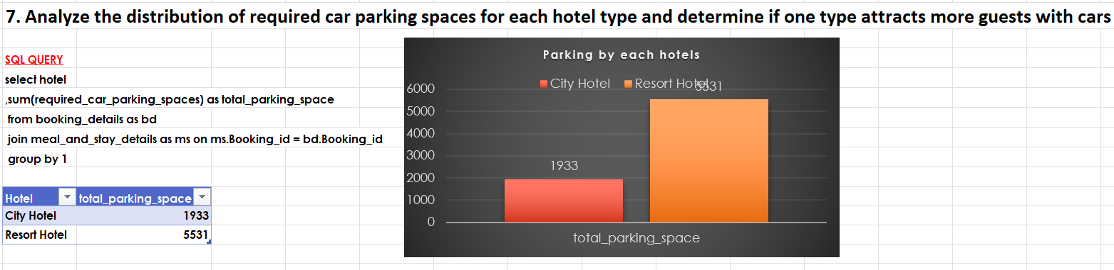
First I’m load the data in the SQL workbench to handle the data and use accordingly which type of the data required . Then write a code on SQL workbench selecting the column hotel and sum of required car parking space as total parking space from booking details and join the meal and stays details and group by hotel table then run the code and copy the code and data then put in the excel then select the data convert into table and change font size and bold then insert the column chart. Its automatically detect the data and then selecting the data value and change the color of color of column is red. We can see that clearly here is two type of hotel resort and city hotel and these hotel having parking space or not .

Slide 42
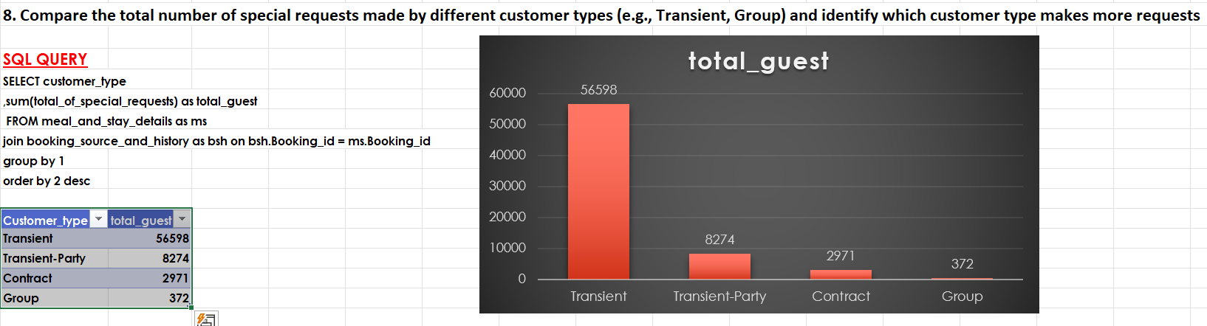
First I’m load the data in the SQL workbench to handle the data and use accordingly which type of the data required Then write a code on SQL workbench selecting the column customer type ,sum of total specials requests as total guest from meal and stays details table and join the booking source and history group by customer type and order by sum of total special guest in desc then run the code and copy the code and data then put in the excel then select the data convert into table and change font size and bold then insert the column chart. Its automatically detect the data and then selecting the data value and change the color of color of column is red. We can see that customer type wise specials guest .

Slide 43
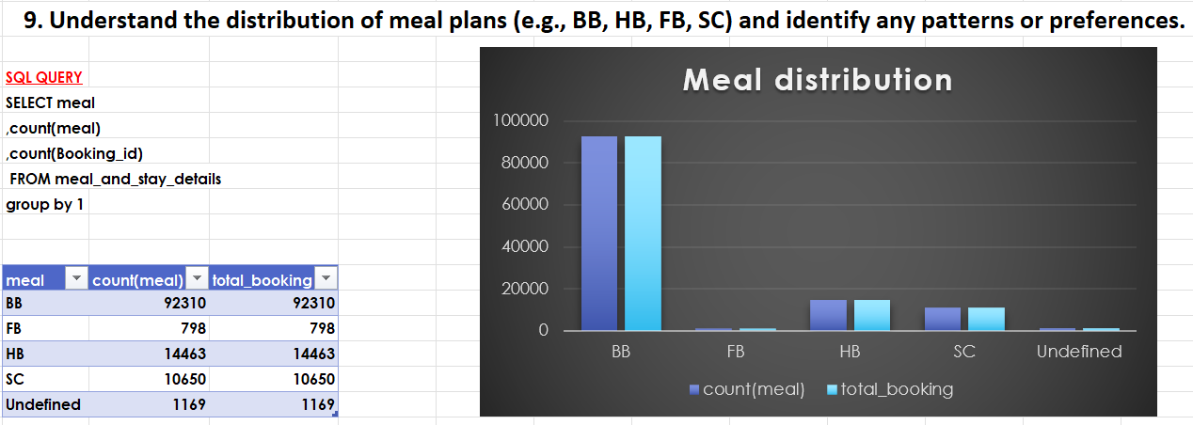
First I’m load the data in the SQL workbench to handle the data and use accordingly which type of the data required Then write a code on SQL workbench selecting the Meal and count of meal ,count of booking id from meal and stays details table group by meal then run the code and copy the code and data then put in the excel then select the data convert into table and change font size and bold then insert the column chart. Its automatically detect the data and then selecting the data value and change the color of color of column is blue. We can see that meal wise count of meal and count of booking id .

Slide 44
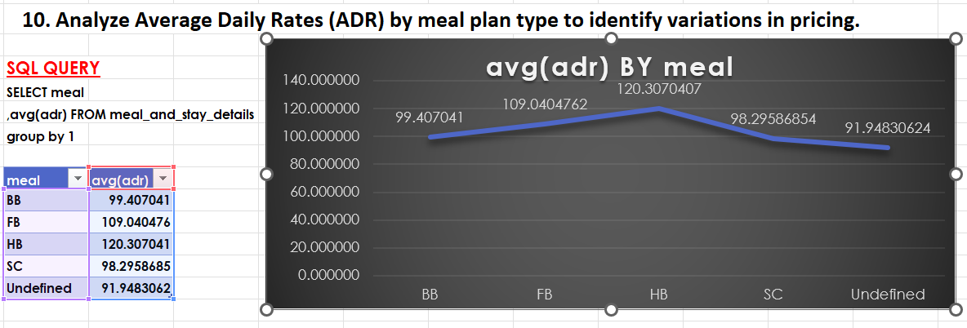
First I’m load the data in the SQL workbench to handle the data and use accordingly which type of the data required Then write a code on SQL workbench selecting the Meal and average adr from meal and stays details table group by meal then run the code and copy the code and data then put in the excel then select the data convert into table and change font size and bold then insert the line chart. Its automatically detect the data and then selecting the data value and change the color of color of column is blue. We can see that meal wise average of ADR.

Slide 45
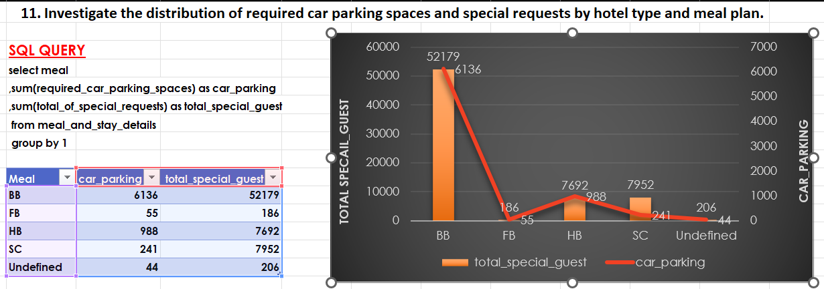
First I’m load the data in the SQL workbench to handle the data and use accordingly which type of the data required Then write a code on SQL workbench selecting the Meal ,Sum of required car parking space and sum of total of special request as total special guest from meal and stays details table group by meal then run the code and copy the code and data then put in the excel then select the data convert into table and change font size and bold then insert the combo chart(column and line chart). Its automatically detect the data and then selecting the data value and change the color of color of column is red. We can see that column chart are shows the total special guest and line chart show car parking space .

Slide 46
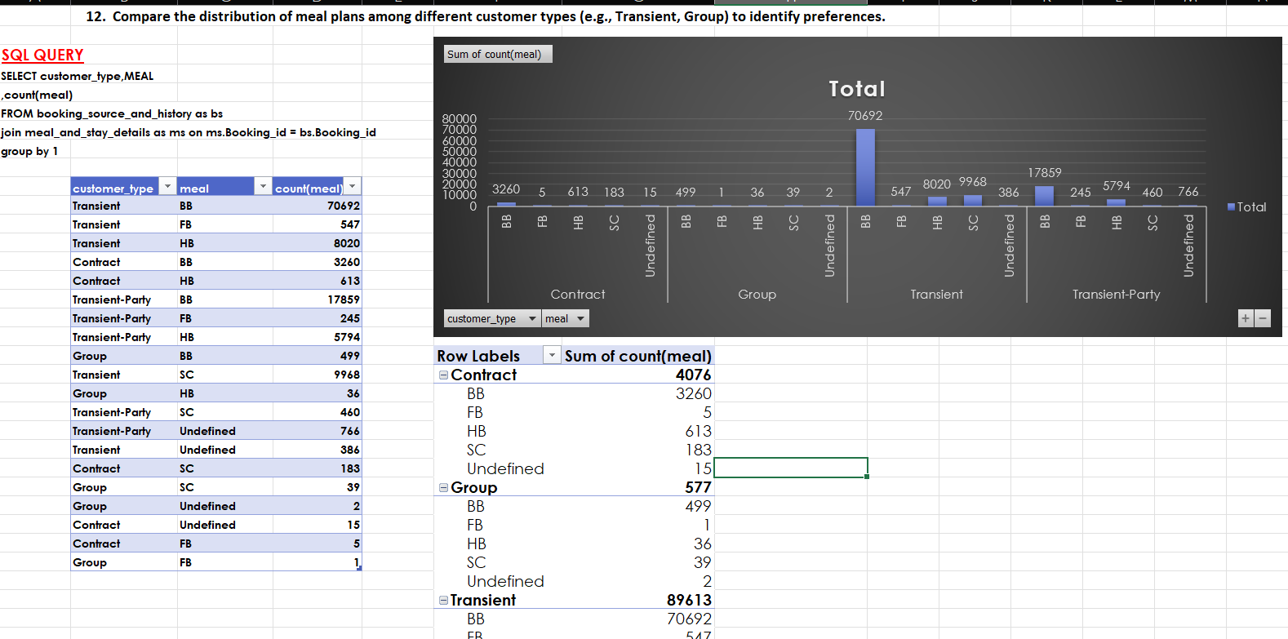

Slide 47
First I’m load the data in the SQL workbench to handle the data and use accordingly which type of the data required Then write a code on SQL workbench selecting the customer type , meal and count of meal from booking source and history as bs and join the table meal and stay details group by customer type and meal then run the code and copy the code and data then put in the excel then select the data convert into table and change font size and bold then insert the column chart . Its automatically detect the data and then selecting the data value and change the color of color of column is red. We can see that column chart are shows the customer type and mela wise count of meal .

Slide 48
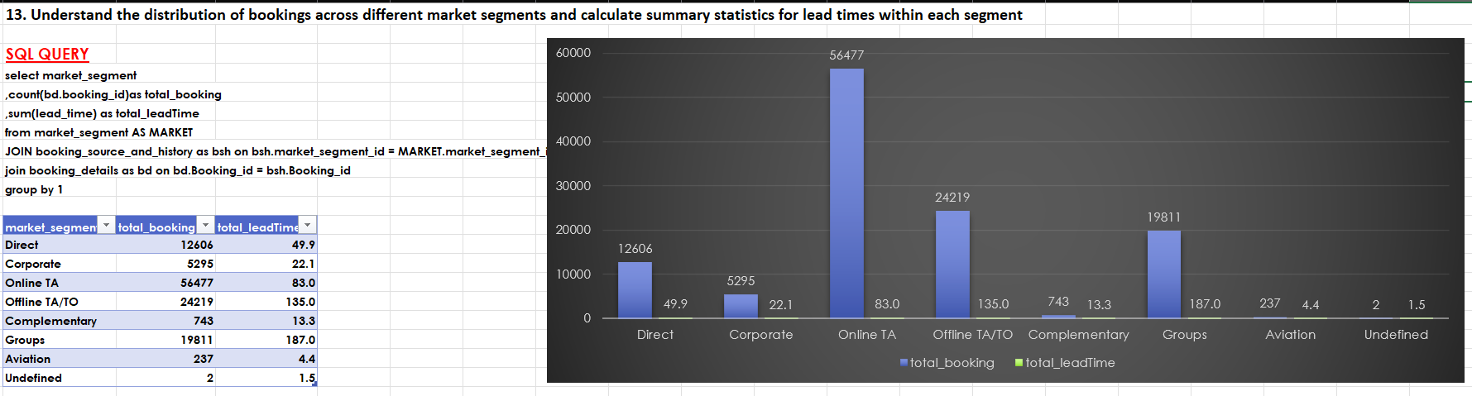
First I’m load the data in the SQL workbench to handle the data and use accordingly which type of the data required Then write a code on SQL workbench selecting the market segment ,count of booking id from booking details as total bookings ,sum of lead time from market segment and join the booking source and history and booking details then group by market segment then run the code and copy the code and data then put in the excel then select the data convert into table and change font size and bold then insert the column chart . Its automatically detect the data and then selecting the data value and change the color of color of column is blue. We can see that column chart are shows the data market segment wise.

Slide 49
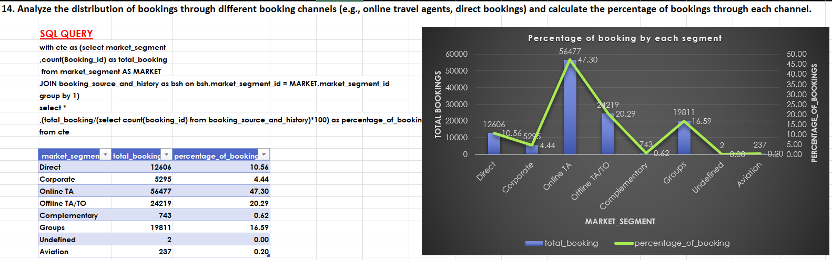
First I’m load the data in the SQL workbench to handle the data and use accordingly which type of the data required Then write a code on SQL workbench selecting the column market segment ,count of booking id as total booking from market segment and join the booking source and history table then group by market segment and then its code store as CTE then selecting the all and total booking/( select count of booking id from booking source and history multiply of 100) as percentage of booking from CTE then run the code and copy the code and data then put in the excel then select the data convert into table and change font size and bold then insert the combo chart(line and column chart). Its automatically detect the data and then selecting the data value and change the color of color of column is blue. We can see that clearly column show market segment and line chart percentage of booking .

Slide 50
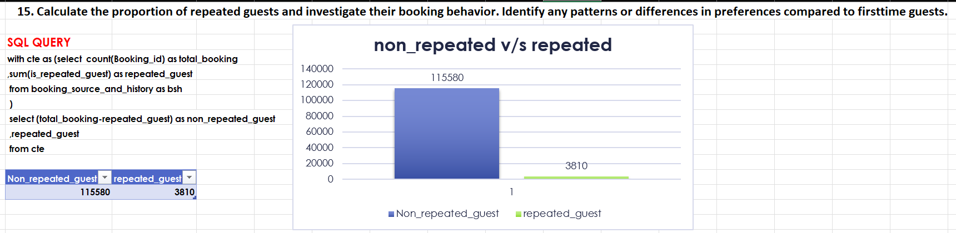
First I’m load the data in the SQL workbench to handle the data and use accordingly which type of the data required Then write a code on SQL workbench then write the code count of booking id as total booking and sum of is repeated guest as repeated guest from booking source and history table as store as cte then subtracting the (total booking and repeated guest )as non repeated guest and repeated guest from cte then run the code and copy the code and data then put in the excel then select the data convert into table and change font size and bold then insert the column chart. Its automatically detect the data and then selecting the data value and change the color of color of column is blue. We can see that clearly compared between non repeated guest and repeated guest.

Slide 51
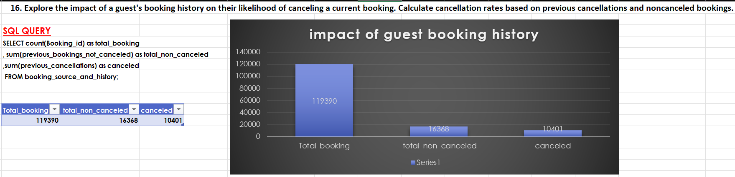
First I’m load the data in the SQL workbench to handle the data and use accordingly which type of the data required Then write a code on SQL workbench the selecting the column count of booking id ,sum of previous bookings not canceled as total non canceled , sum of previous cancellation as canceled from booking source and history table then run the code and copy the code and data then put in the excel then select the data convert into table and change font size and bold then insert the column chart. Its automatically detect the data and then selecting the data value and change the color of color of column is blue. We can see that total booking ,total non canceled ,canceled its show by each column..

Slide 52

First I’m load the data in the SQL workbench to handle the data and use accordingly which type of the data required . Then write a code on SQL workbench selecting the sum of booking change as booking changes , sum of is canceled as cancellation Rate and count of booking id from booking details as total bookings from room details join the table booking details then run the code and copy the code and data then put in the excel then select the data convert into table and change font size and bold then insert the pie chart. Its automatically detect the data and then selecting the data value its shows as percentage and change the color of color of column is blue , green ,lite green. We can see that clearly here booking changes , cancellation rate , total bookings .

Slide 53

First I’m load the data in the SQL workbench to handle the data and use accordingly which type of the data required Then write a code on SQL workbench selecting the column customer type ,reserved room type as room type and count of reserved room type from booking source and history and join the room details table then group by customer type , reserved room type then run the code and copy the code and data then put in the excel then select the data convert into table and change font size and bold then insert the column chart . Its automatically detect the data and then selecting the data value and change the color of color of column is red. We can see that column chart are shows the data customer type wise.

Slide 54

First I’m load the data in the SQL workbench to handle the data and use accordingly which type of the data required . Then write a code on SQL workbench selecting the column arrivals date year , customer type , assigned room type and count of booking id from booking details as bsh and join the table booking details and join room details then group by arrival date year ,customer type , assigned room type then run the code and copy the code and data then put in the excel then select the data convert into table and change font size and bold then insert the line chart. Its automatically detect the data according the data month wise average lead time according the months and then selecting the data value and change the color of line is red. We can see that clearly year and customer type wise count of booking id and highest one in 2016 transient customer type .

Slide 55

First I’m load the data in the SQL workbench to handle the data and use accordingly which type of the data required Then write a code on SQL workbench selecting the column month of reservation status date , reservation status and count of reservation status as total reservation from reservation status then group by month of reservation status date , reservation status then order by count of reservation status descending then run the code and copy the code and data then put in the excel then select the data convert into table and change font size and bold then insert the column chart . Its automatically detect the data and then selecting the data value and change the color of color of column is red. We can see that column chart are shows the data month wise reservation status and count of reservation status as total reservation.

Slide 56

First I’m load the data in the SQL workbench to handle the data and use accordingly which type of the data required Then write a code on SQL workbench selecting the column reservation status date ,reservation status and count of reservation status as total reservation from reservation status where reservation status is equal to check out then group by reservation status date and reservation status and order by total reservation then run the code and copy the code and data then put in the excel then select the data convert into table and change font size and bold then insert the line chart . Its automatically detect the data and then selecting the data value and change the color of color of column is blue. We can see that column chart are shows the data reservation status date and reservation status wise count of reservation status .

Slide 57

First I’m load the data in the SQL workbench to handle the data and use accordingly which type of the data required Then write a code on SQL workbench selecting the column customer type ,reservation status and sum of is canceled as cancelation rate from booking details and join the booking source and history table and join reservation status then group by customer type , reservation status then run the code and copy the code and data then put in the excel then select the data convert into table and change font size and bold then insert the column chart . Its automatically detect the data and then selecting the data value and change the color of color of column is red. We can see that column chart are shows the data customer type and reservation status wise sum of is canceled as cancelation rate.

Slide 58

First I’m load the data in the SQL workbench to handle the large data and selecting the column and using the case when reservation status is equal to canceled then canceled ,when reservation status is equal to check out then check out else 0 end ) as reservation and using the round formula to sum of adr as total adr from reservation status and join meal and stay details then group by reservation limit 2 then run the code and copy the code and data then put in the excel then select the data convert into table and change font size and bold then insert the column chart . Its automatically detect the data and then selecting the data value and change the color of color of column is red. We can see that column chart are shows the data check-out and canceled .

Slide 59
Thank you

